Slide 1



PRESENTATION
Comprehensive SEO Audit for Focus Softnet

Slide 2
INTRODUCTION
OVERVIEW
Established in 1992, Focus Softnet is a multinational IT solutions provider, specializing in ERP, CRM, and HCM software. Operating in 17 countries, they offer cloud-hosted and customizable business management solutions.
Services Offered:
ERP Solutions: Industry-specific, cloud-hosted, customizable.
CRM Solutions: Advanced marketing, sales, and service tools.
HCM Solutions: Automated HR and payroll management.

Slide 3
INTRODUCTION
Areas of Expertise:
Manufacturing, Real Estate, Education, Retail, and Automotive sectors.
Pros:
Customizable and scalable solutions.
Cloud and on-premise deployment options.
Industry-specific modules.
Cons:
Complex implementation may require significant customization.
Potential high costs for small businesses.

Slide 4

PROJECT GOALS
HIGHLIGHTS
OBJECTIVES:
Identifying and addressing SEO issues
Increase organic traffic
Improve search engine rankings
Enhance overall online visibility

Slide 5
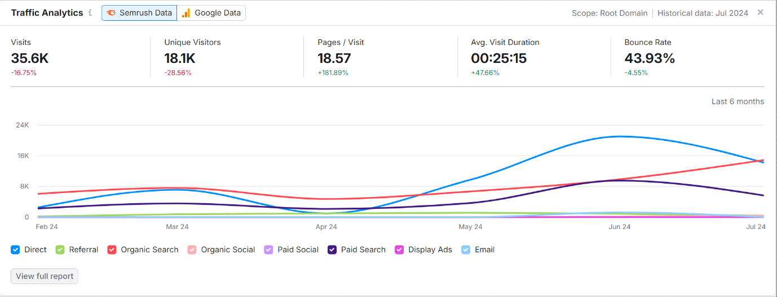
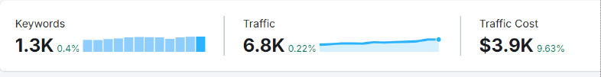
SEO AUDIT OVERVIEW
CURRENT PERFORMANCE:
Speed: Good loading times but could improve on mobile.
Mobile Optimization: Responsive design, though minor adjustments may enhance usability.
Content Quality: Comprehensive, with industry-specific details, but lacks frequent updates.

Slide 6
KEYWORD RESEARCH
No | Position | Keyword | SEO Difficulty | Search Volume
1 | 52 | ERP system | 71 | 14800
2 | 61 | ERP software | 75 | 18100
3 | 67 | ERP | 48 | 135000
4 | 70 | Enterprise resource management systems | 14 | 18100
5 | 85 | CRM software | 32 | 22200
6 | 90 | Enterprise resource planning | 76 | 135000
7 | 97 | Enterprise resource systems | 23 | 22200

Slide 7
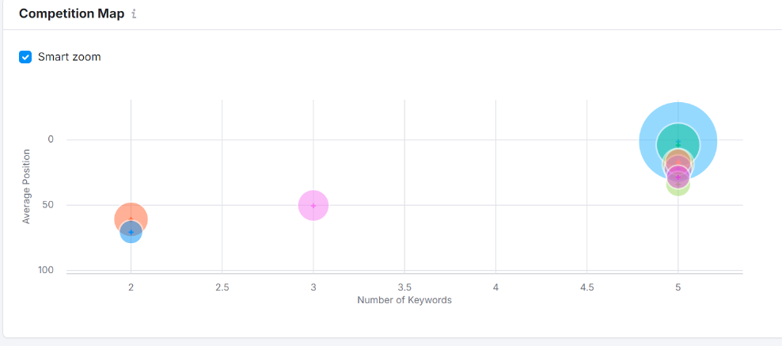
COMPETITVE ANALYSIS
COMPETITORS
Tally Solutions
Zoho
SAP (SAP Business One)
Oracle (NetSuite)
Microsoft Dynamics 365
CONCLUSION:
Focus Soft net can enhance its competitive positioning in India by addressing content gaps, targeting SMEs with localized solutions, and leveraging both SEO and paid campaigns to capture a broader audience. Emphasizing thought leadership and industry-specific expertise will also help differentiate from larger, more established competitors.

Slide 8
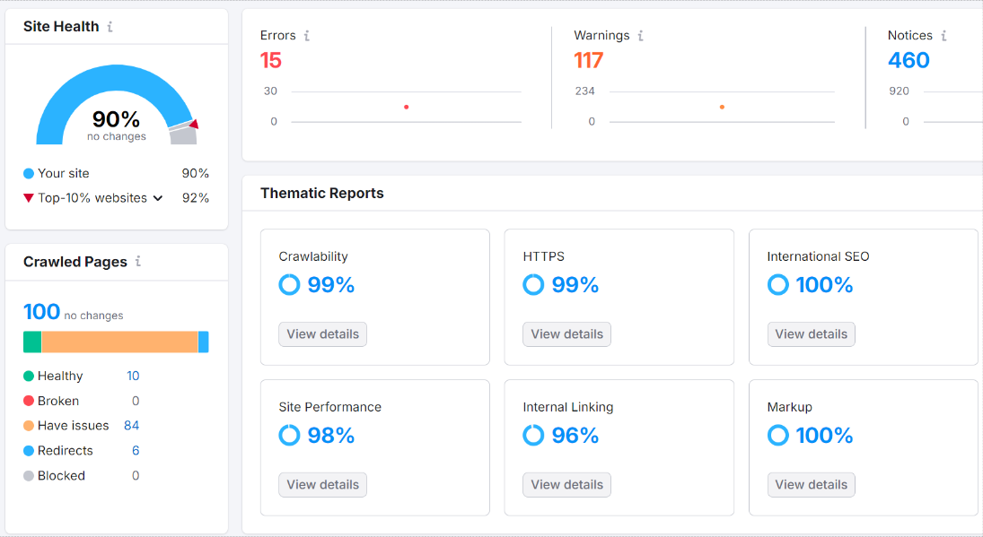
ON PAGE SEO
WEBPAGES
https://www.focussoftnet.com/icici/
https://www.focussoftnet.com/in/centra-crm-software?srsltid=AfmBOooUVliDiD-3-_1ErqPN0dzec4uTB_aXqwl-1j2nedZRFIgfquQO
https://www.focussoftnet.com/in/e-invoicing-system?srsltid=AfmBOoo8IDLVqXabI7Py0ST2BEKZ3za_spbKUkrl0L4RNudvtw6ny6NB

Slide 9
ON PAGE SEO
HTTPS://WWW.FOCUSSOFTNET.COM/ICICI/
The SEO title is set and is 46 characters long.
The meta description is set and is 154 characters long.
One or more keywords were found in the title and description of the page.
One H1 tag was found on the page
H2 tags were found on the page.
All images on the page have alt attributes.
The page has a correct number of internal and external links.

Slide 10
ON PAGE SEO
HTTPS://WWW.FOCUSSOFTNET.COM/IN/CENTRA-CRM-SOFTWARE?SRSLTID=AFMBOOOUVLIDID-3-_1ERQPN0DZEC4UTB_AXQWL-1J2NEDZRFIGFQUQO
The SEO title is set and is 61 characters long.
The meta description is 210 characters long, which is too long.
One or more keywords were found in the title and description of the page.
One H1 tag was found on the page.
H2 tags were found on the page.
All images on the page have alt attributes.
The page has a correct number of internal and external links.

Slide 11
ON PAGE SEO
HTTPS://WWW.FOCUSSOFTNET.COM/IN/E-INVOICING-SYSTEM?SRSLTID=AFMBOOO8IDLVQXABI7PY0ST2BEKZ3ZA_SPBKUKRL0L4RNUDVTW6NY6NB
The SEO title is set and is 57 characters long.
The meta description is set and is 150 characters long.
One or more keywords were found in the title and description of the page.
One H1 tag was found on the page.
H2 tags were found on the page.
Some images on the page have no alt attribute. (7)
The page has a correct number of internal and external links.

Slide 12
TECHNICAL SEO
ISSUES IN TECHNICAL SEO OF WEBPAGES
The server is not using "expires" headers for the images.
The page makes 33 requests. More than 20 requests can result in slow page loading.
No Schema.org data was found on your page.

Slide 13
TECHNICAL SEO
5 BEST PRACTICES TO IMPROVE SITE AND WEB PAGE SPEED
1. Optimize Images
Compress Images
Use Appropriate Formats
Implement Lazy Loading.
2. Minify CSS, JavaScript, and HTML
Remove Unnecessary Code
Combine Files
Defer JavaScript
3. Enable Browser Caching
Set Expiry Headers
Use a Content Delivery Network (CDN)
4. Reduce Redirects and Remove Unnecessary Plugins
Limit Redirects
Remove Unnecessary Plugins
5. Optimize Server Response Time
Reduce Server Response Time
Use a Reliable Hosting Provider
Implement GZIP Compression

Slide 14
CONTENT STRATEGY OVERVIEW
Objective: Enhance brand visibility, drive qualified leads, and educate the market.
Target Audience: SMEs, large corporations, decision-makers like CEOs, CTOs, and IT Managers.
Keyword-Driven Themes: ERP software, CRM solutions, business automation.
Content Focus: Educational posts, case studies, industry-specific insights, and thought leadership.
Content Formats: Blog Posts, Videos & Infographics, Webinars
Content Calendar: Thematic monthly content, regular blog posts, and timely seasonal content.
Performance Metrics: Monitor organic growth, engagement, lead generation, and conversion rates using analytics tools.

Slide 15
OFF PAGE SEO
STRATERGIES
High-Quality Backlink Acquisition: Guest Posting, Industry Directories, Partnerships & Alliances.
Content Syndication: Publish on Platforms, Press Releases.
Social Media Engagement: Content Sharing, Influencer Outreach.
Online Community Participation: Forums & Q&A Sites, Industry Groups.
Local SEO & Citations: Google My Business, Local Citations.
Content Marketing for Link Building: Create Linkable Assets, Skyscraper Technique.
Monitor and Disavow Toxic Links: Backlink Audit, Disavow Tool.
Competitor Analysis: Backlink Gap Analysis, Content Opportunities.

Slide 16
CONCLUSION
SEO AUDIT OF FOCUS SOFTNET
Technical SEO: Optimizing crawlability and indexability (e.g., text-to-HTML ratio, broken scripts).
Content Strategy: Focusing on industry-specific content, educational resources, and thought leadership.
Off-Page SEO: Building high-quality backlinks, engaged on social media, leveraged influencer outreach.
Outcome of the project: Improve search visibility, increased organic traffic, and higher conversions for sustained growth in the ERP market.

Slide 17
THANK YOU
BY
KIRUBHA MAHESAN

